Slide 1

Producing accessible reports
Power BI
Notes:
Hello everyone and welcome to today’s session
This is a 3-hour session with approx. 10 minutes at the end for a Q&A
The presentation will be recorded so that you can review and share the content with colleagues.

Slide 2


Speakers
Andrea Kennedy
Digital Accessibility Architect
Purple Associate
Notes:
This workshop has been developed in partnership with Andrea Kennedy, a Purple Associate with over 20 years expertise in the field of digital accessibility. Andrea discovered a passion for disability access technology after having an accident which left her with a disability and limited use of one arm.
She since has co-developed technology based social enterprises for major charities, both in the UK and Poland and has advised many organisations on access technologies and accessible digital environments, disability at work policies and supported employment services, in the UK, US, Turkey and Qatar. Lets now look at what we will cover in todays session

Slide 3
What we will cover:
Understanding your audience
Disability types
WCAG 2.1 Design Principles
Tiny test report
Q&A

Slide 4
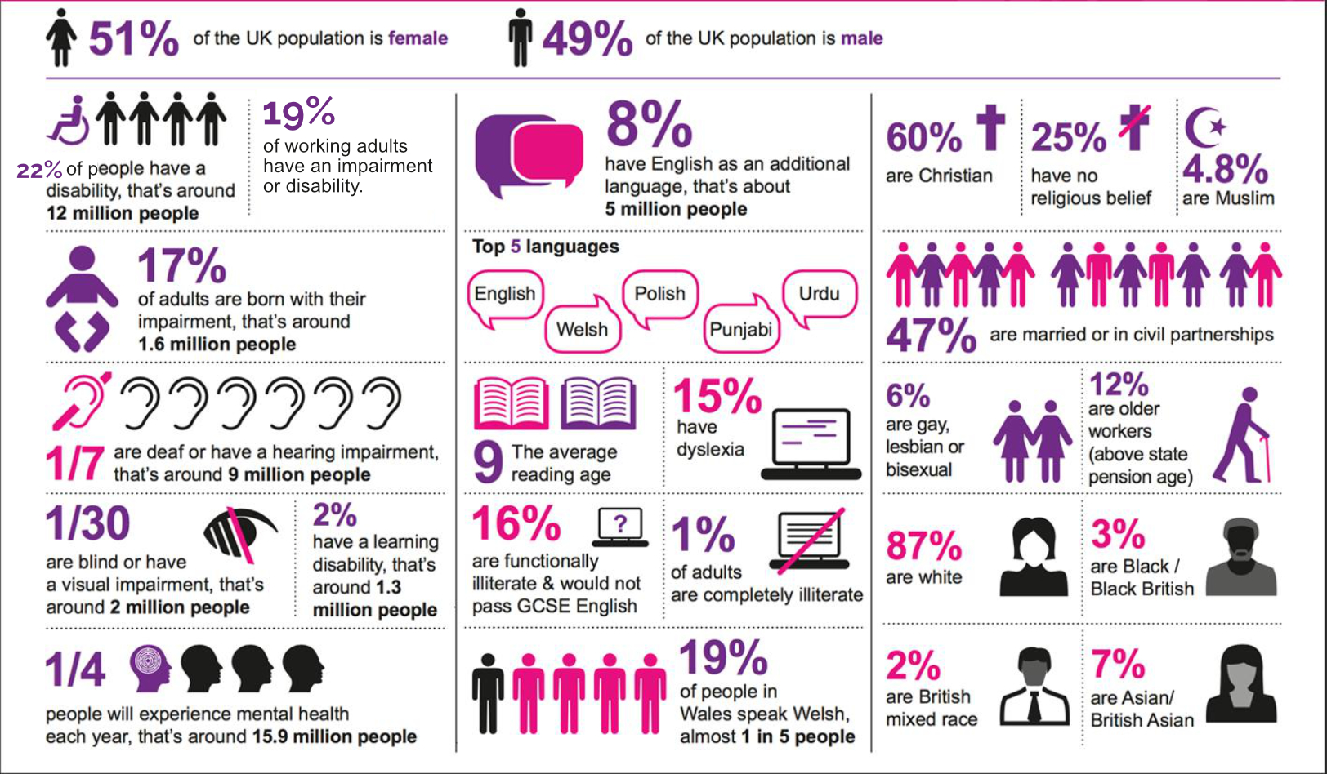
Who are we communicating with?
Notes:
This slide shows the UK through a ‘lens’ of diversity and inclusion statistics and in some way, we are all represented here and are in more than one “box”
we need to keep this in mind when we are communicating with different people.
It was developed using Census data and statistics from credible national sources, e.g. national charities.
The infographic can be used in different ways, it is a useful tool for helping to dispel myths around the prevalence of certain groups.
Of particular interest here are the statistics around reading age and dyslexia as they can impact heavily on a person’s ability to understand or access written communications (emails, websites, flyers, meeting notes etc).
The text detail is on the following slide

Slide 5
Infographic in text
51% of the UK population is female. 49% or the UK population is male. 225 of people have a disability, that’s around 12 million people. 8% have English as a second language, that’s about 5 million people. 60% are Christian. 25% have no religious belief. 8% are Muslim. 17% of adults are born with their impairment, that’s around 1.6 million people. The top 5 languages int eh UK are English, Welsh, Polish, Punjabi and Urdu. 47% are married or in a civil partnership. 1 in 7 people are deaf or have a hearing impairment. That’s around 9 million people. The average reading age is 9 years of age. | 15% have dyslexia. 6% are gay, lesbian or bisexual. 12% are older workers (above state pension age). 1 in 30 are blind or have a visual impairment, that’s around 2 million people. 2% have a learning disability, that’s around 1.3 million people. 16% are functionally illiterate and would not pass GCSE English. 1% of adults are completely illiterate. 87% are white. 3% are black/ black British. 1 in 4 people will experience mental health issues each year. That’s around 15.9 million people. 19% of people in Wales speak Welsh, that’s 1 in 5 people. 2% are British mixed race. 7% are Asian/ British Asian.

Slide 6


Mobility Impaired users
May not be able to use a mouse and/or keyboard
May use different modes of access
And a wide range of assistive devices and technologies
Access can be slowed by heavy navigation
May use alternative orientations.

Slide 7

Low Vision Users
Text may not be large enough to read
Contrast between text and the background may not be sufficient
Cater for all Environments

Slide 8

Cognitive Impairments
There are many different types of cognitive impairment
Reading age may be lower
May be easily distracted
Information needs to be obvious
Instructions need to be exact

Slide 9

D/deaf or hard of Hearing Users
English is a second language, so do not use jargon
Spoken words and some sounds may need text alternatives
Video need captions

Slide 10

Blind Users
Use a screen reader to read the report
Different types of screen readers
Most like to read in linear style
Heavily reliant on the mercy of designers and developers!
Notes:
Alt shift F11

Slide 11

Design to avoid stress
Stress affects all of us but those with disabilities may feel the stress of any given situation, more acutely.
Our work and social life has changed immensely. This brings with it new stresses previously not factored.
Ensure your reports do not require learning before information can be gathered.
Notes:
Provide instruction!

Slide 12

Question
What types of ways can someone interact with a report? Not just in terms of tech but also in terms of environment?
Notes:
use a keyboard instead of a mouse
change browser settings to make content easier to read
use a screen reader to ‘read’ (speak) content out loud
use a screen magnifier to enlarge part or all of a screen
use voice commands to navigate a website

Slide 13

WCAG 2.1
WCAG 2.1 is based on 4 design principles:
Perceivable
operable
understandable
robust
By focusing on principles, not technology, they emphasise the need to think about the different ways that people interact with different content.

Slide 14

Universal design principles
Notes:
Universal design is the design of products that are usable by as many people as reasonably possible, without the need for special adaptation or specialized design.

Slide 15

Keep it simple
Keep your report as simple as possible. People often try to put too much into a single visual.
Multiple visuals makes it simpler and easy to understand.
At the same time, keep the number of visuals on a page to a minimum.
Try to avoid unnecessary redundancy and page clutter.
Notes:
You don't need two visuals to show the same thing. Report consumers may get overwhelmed from all the information being given from too many visuals, or they may have a limited attention span and get distracted. Not only does this make your report easier to consume, but also having too many visuals on a page can slow down the performance of your report.
Consider using multiple visuals if they show different facets of the data and use filters or visual interactions to create a rich experience.

Slide 16
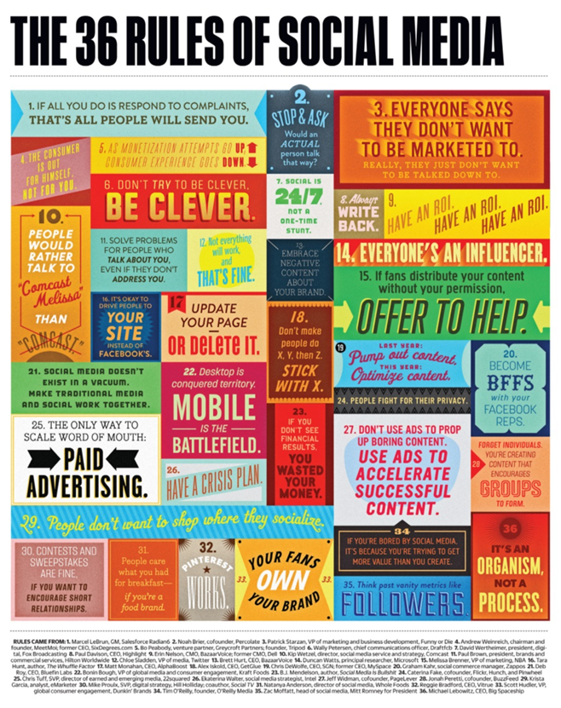
Be consistent
Be consistent in your style and colour of fonts etc
Use the same font size for all visual titles, just as you should for data labels and axis titles.
If you're using slicers on multiple report pages, keep them in the same location on every page of your report.

Slide 17


Font readability
Snap
Blackadder
Copperplate
Brush Script MT
Freestyle Script
Times New Roman
Verdana
Calibri
Tahoma
Arial
Corbel
Century Gothic

Slide 18
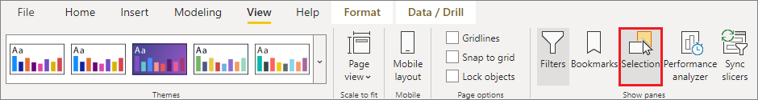
Tab order
Setting the tab order helps keyboard users navigate your report in an order that matches the way users visually process the report visuals. If you're including decorative shapes and images in your report, you should remove those from the tab order.
To set the tab order, select the View tab in the ribbon and under Show panes, select Selection to display the Selection pane.

Slide 19
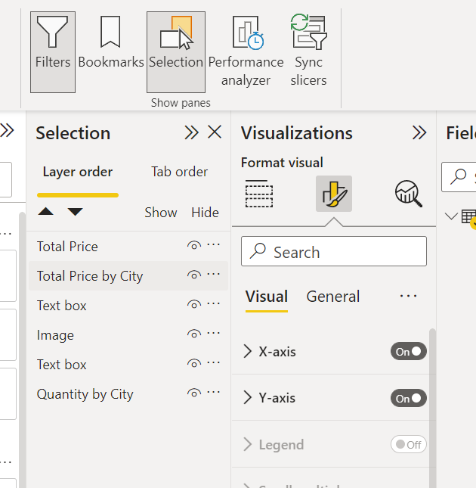
Tab order list
Slide the TAB order up and down in the list to reflect the desired order.
Traditionally a left to right, up to down, order is used in the UK.

Slide 20
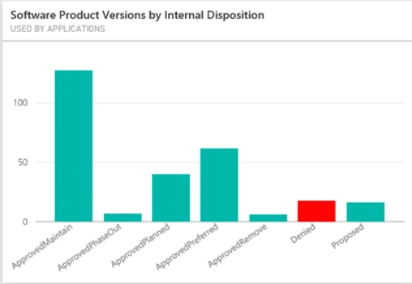
Do not use colour alone
Do not use colour alone to signify information .
non visual users cannot perceive colour
people with colour perception differences may perceive information differently .
Approximately 4.5% of UK population are colour blind
Notes:
Colour (color) blindness (colour vision deficiency, or CVD) affects approximately 1 in 12 men (8%) and 1 in 200 women in the world. In Britain this means that there are approximately 3 million colour blind people (about 4.5% of the entire population), most of whom are male

Slide 21
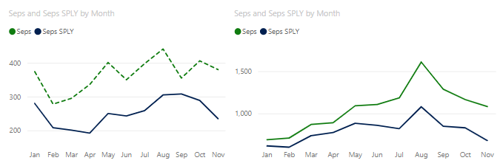
Lines & Markers
Adding ‘texture’ to your colour, gives an added way to differentiate information. Should someone not be able to perceive colour, they will be able to perceive shape.
Customized markers will also enhance the accessibility of these graphs.
Notes:
To turn Markers on, select the Format section in the Visualizations pane, expand the Shapes section, then scroll down to find the Show Markers toggle and turn it to

Slide 22
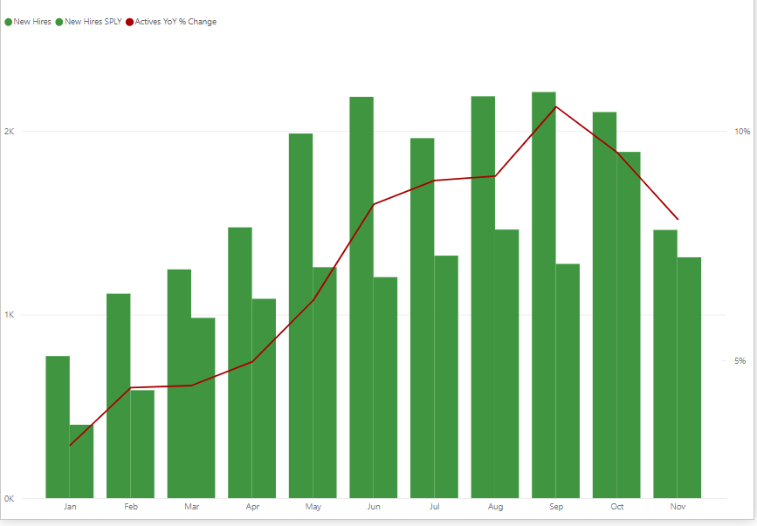
Do not use colour alone but do use colour!
Colour plays a huge role in allowing us to differentiate information.
Using different colors can separate and define different data points within a visualization so that viewers can easily distinguish significant differences or similarities in values.
For text, ensure color contrast between font and background are at least 4.5:1.
Notes:
Some colours induce a feeling of pleasure in the observer. When an affectively positive, or pleasurably perceived, colour is viewed after a less-pleasant colour, it produces more pleasure than when viewed by itself, an effect known as affective contrast enhancement.
Britanica.com

Slide 23
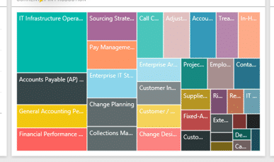
Limit your colours and styles
Overly coloured charts and diagrams are confusing for most people.
Some people with certain types of autism may even feel threatened by too much colour.
Notes:
Colour contrast analyser

Slide 24
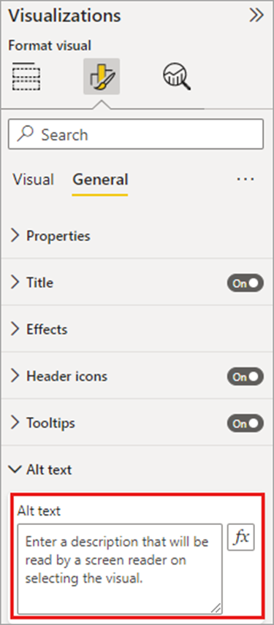
Alternative Text
Add alt text to every object that conveys meaningful information on a report.
Providing alt text ensures that consumers of your report understand what you are trying to communicate with a visual, even if they cannot see the visual, image, shape, or textbox.
Notes:
You can provide alt text for any object on a Power BI Desktop report by selecting the object (such as a visual, shape, and so on) and in the Visualizations pane, select the Format section, expand General, scroll to the bottom, and fill in the Alt Text textbox. The Alt Text textbox has a limit of 250 characters.

Slide 25
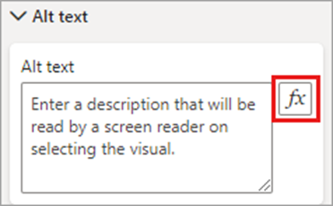
Conditional formatting for alt text
One feature that makes Power BI so compelling is that its data is dynamic. You can use DAX measures and conditional formatting to create dynamic alt text. Screen readers are then able to call out values specific to the data that a report consumer is viewing.

Slide 26
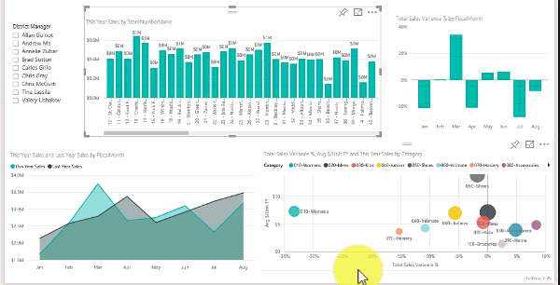
Slicers
If you have a collection of several slicers on your report pages, ensure your design is consistent across pages. Use the same font, colours, and spatial position as much as possible.

Slide 27
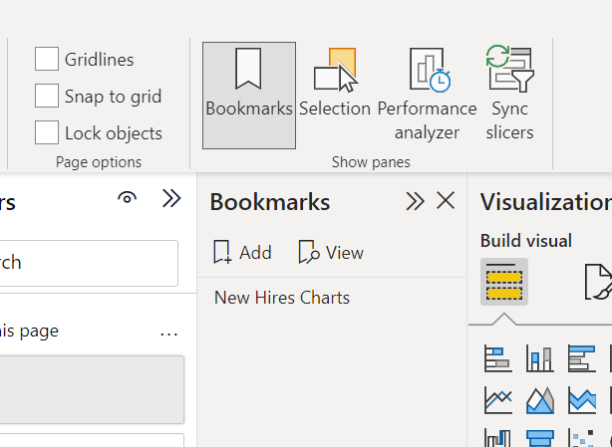
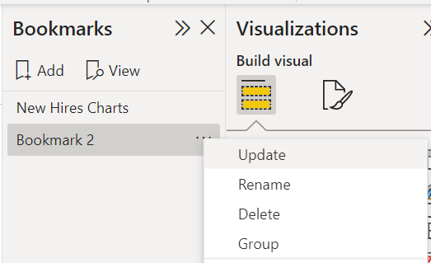
Visual interactions
Is key information only accessible through an interaction? If so, rearrange your visuals so they are pre-filtered to make the important conclusion more obvious.
Are you using bookmarks for navigation? Try navigating your report with a keyboard to ensure the experience is acceptable for keyboard-only users.
Does your report need instruction?

Slide 28
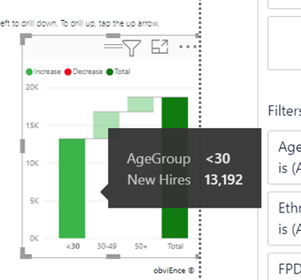
Tooltips
Don't use tooltips to convey important information. Users with motor issues and users who do not use a mouse will have difficulties accessing them.
Do add tooltips to charts as ancillary information. It is included in the accessible Show Data table for each visual.

Slide 29

Shapes
Make sure any decorative shapes are marked as hidden in tab order, so they aren't announced by a screen reader.
Avoid using too many decorative shapes to the point where they are distracting.
When using shapes to call out data points, use alt text to explain what is being called out.

Slide 30


Audio & Video
Video
Avoid video that automatically starts when the page is rendered.
Ensure your video has captions or provide a transcript.
Audio
Avoid audio that automatically starts when the page is rendered.
Provide a transcript for any audio.
Notes:
1.Audio and video files should meet the standard criteria for the HTML5 <audio> or <video> tag. There are some limitations in terms of file type (mp3, ogg), etc.
2.Audio and video content should be hosted online with a publicly accessible URL.
3.Sound or video will only work in Power BI Service. Controls will display in Power BI Desktop, but no content will load.

Slide 31

Power BI visuals
Check the accessible Show Data table for Power BI visuals. If the information shown is not enough, look for another visual.
If using the Play Axis custom visual, ensure it does not auto play. Make it obvious that the user must press the play/pause button to start/stop the changing values.
Use shortcut key Alt, Shift + F11 to display a table
Notes:
https://appsource.microsoft.com/en-GB/product/power-bi-visuals/WA104380981?tab=DetailsAndSupport

Slide 32
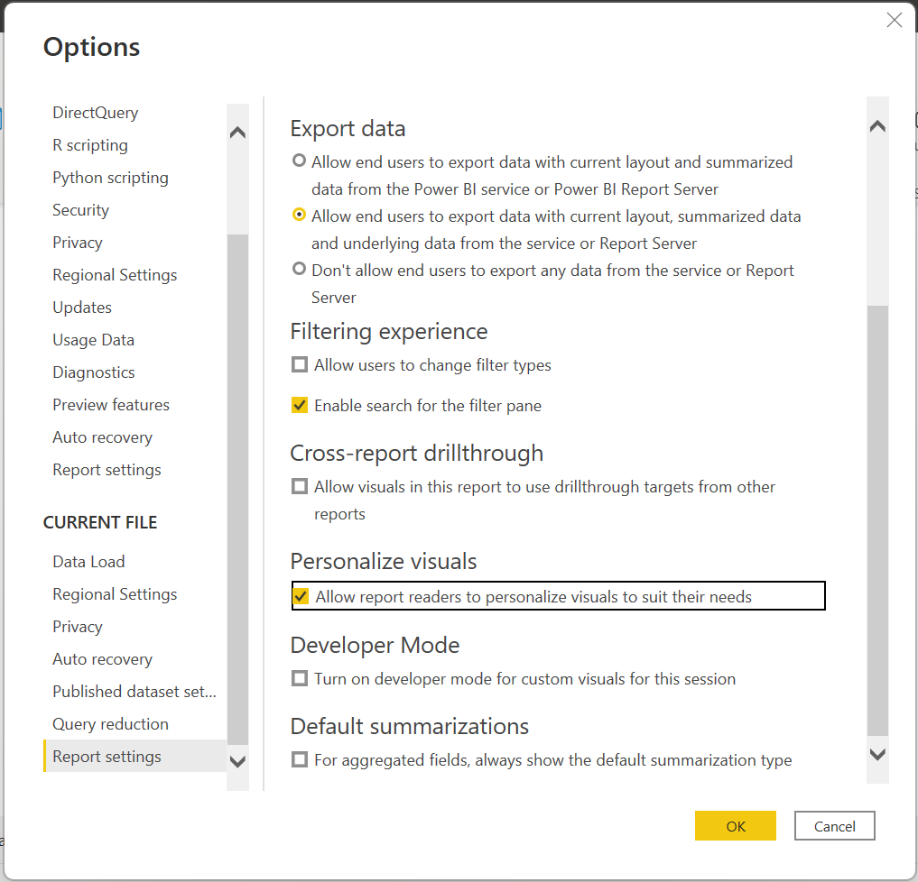
Personalisation
Personalisation is very important for users with disabilities.
Many people will have access to their own assistive technology but many will only need to make some minor changes on their browser or computer to allow ease of access.
Ensure you allow personalisation in your reports.
Notes:
To enable the feature in Power BI Desktop, go to File > Options and settings > Options > Current file > Report settings. Make sure Personalize visuals is turned on.

Slide 33
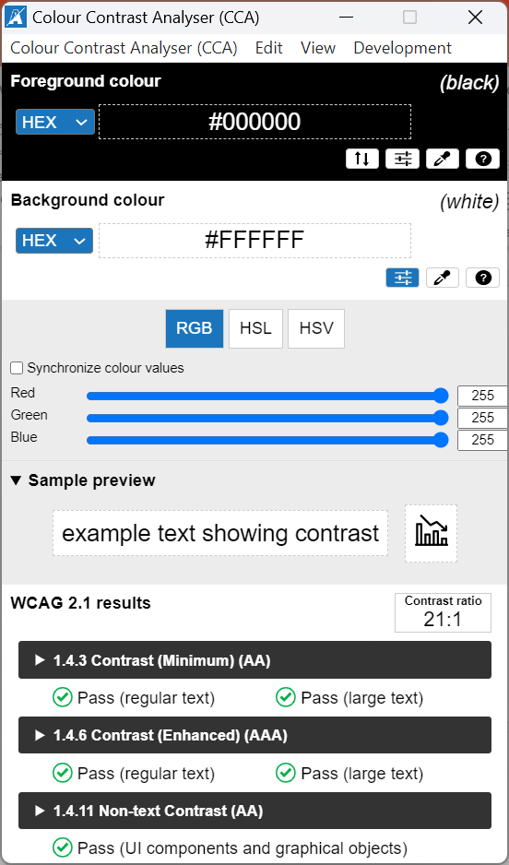
Themes, contrast and colourblind-friendly colours
As we have already seen, WCAG 2.1 success criterion 1.4.3 states that text and background color should have a contrast ratio of at least 4.5:1.
Use tools such as Color Contrast Analyzer, WebAIM, and Accessible Colors you can use to test your report colours.
Notes:
https://www.tpgi.com/color-contrast-checker/

Slide 34
Colour contrast tools
https://www.tpgi.com/color-contrast-checker/ Standalone
https://webaim.org/resources/contrastchecker/ For web browsers
https://accessible-colors.com/ Hex values needed

Slide 35
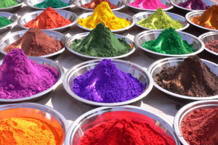
Colour blindness
Certain color combinations are particularly difficult for users with color vision deficiencies to distinguish. These include the following combinations:
• green and red
• green and brown
• blue and purple
• green and blue
• light green and yellow
• blue and grey
• green and grey
• green and black

Slide 36
Online colour related simulations
You should also consider that some report viewers may have color vision deficiencies. Tools like ’Coblis’ and ’Vischeck’ simulate what report viewers with different color deficiencies see. Using fewer colours or a monochrome palette in your report can help mitigate creating reports that are inaccessible.
https://www.color-blindness.com/coblis-color-blindness-simulator/
https://www.vischeck.com/vischeck/vischeckImage.php

Slide 37
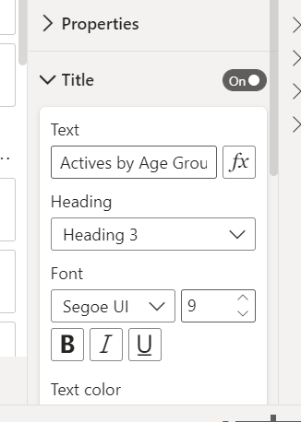
Titles and labels
Visual and report page titles are important accessibility features that orient the report consumer.
Avoid using acronyms or jargon in your report titles
Frontload titles to ensure important information is read first.
Notes:
If you share the report to a new user or someone who is external to your organization, they may not know what your terms or acronyms mean.

Slide 38

Exercise
What barriers might the following groups of people encounter when viewing the sample report?
Blind/sight loss/visually impaired
Deaf/hearing loss/hearing impairment
Mobility impairment/physical disability
Cognitive Impairments/Learning difficulty or disability

Slide 39
Thank you

